Slide 1

PROJECT FINAL PRESENTATION
AI Diagnosis: Brain Tumor Analysis
Khanh Huynh, Dylan Legault, Grisel Barrera, Dat Nguyen

Slide 2







System Architecture & Technology Stack
Core Stack
Hardware
Outcome
Python-based environment utilizing TensorFlow/Keras for AI modeling and OpenCV for noise reduction.
NVIDIA GPU acceleration via Google Colab to manage heavy training cycles of clinical datasets.
A standardized 224x224 diagnostic pipeline ready for multi-modal surgical and clinical integration.
[Source: Project Report Phase 1-2: Infrastructure]

Slide 3

Introduction & Presentation Agenda
The Goal
Develop a multi-class AI model to assist radiologists in identifying Glioma, Meningioma, and Pituitary tumors with high diagnostic sensitivity and explainable results.
01. Solution & Infrastructure
02. Clinical Cleaning Workflow
03. Model Architecture Deep Dive
04. Technical Implementation & XAI
05. Quantitative Evaluation
06. Frontend Dashboard & Demo

Slide 4
Clinical Cleaning & Data Prep Flow
Before model training, raw MRI images (7,200+ samples) pass through a 6-step diagnostic pipeline to ensure uniformity and noise removal.
Grayscale
Blur
Threshold
Contour
Crop
Color simplification
Noise smoothing
Binary masking
Brain detection
Centering image
Result: Standardization critical for Convolutional Neural Network (CNN) layer consistency.

Slide 5

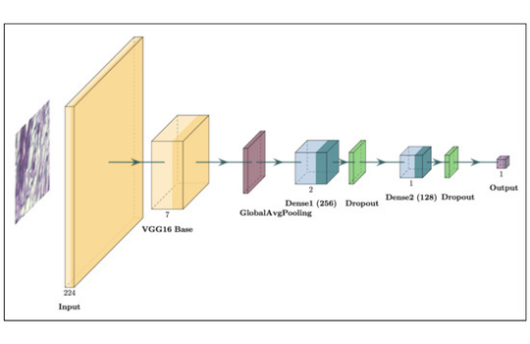
Hybrid Model Design Architecture
• Hybrid VGG16: Integrated pre-trained ImageNet expert fine-tuned for brain MRI data patterns.
• Optimizer: Adam with Categorical Cross-Entropy for multi-class (4 label) convergence.
Layer Target: block5_conv3 for XAI heatmap integration

Slide 6
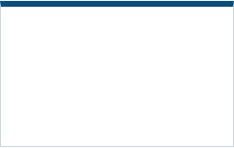
Quantitative Evaluation Results
91% Overall Accuracy
Actual \ Predicted | Glioma | Meningioma | No Tumor | Pituitary
Glioma | 306 | 66 | 26 | 2
Meningioma | 19 | 366 | 6 | 9
No Tumor | 2 | 1 | 397 | 0
Pituitary | 1 | 10 | 0 | 389
Precision
Recall
0.91
0.91
Confusion matrix shows strong sensitivity in "No Tumor" and "Pituitary" classes.

Slide 7


Product Demo
LIVE SHOWCASE: STREAMLIT DASHBOARD

Slide 8
Physician Dashboard & Frontend UI
The system is deployed via a Gradio interface for the capstone project, however, for commercially scale, it can be deployed via Streamlit so doctors don't need to interact with code.
Simple Image Upload Button
Automated Confidence Score Display
One-click Report Generation

Slide 9

Technical Insight
AI
Responsible Support Tool
Our model achieves 91% accuracy, serving as a robust decision-support tool. It is designed to assist, not replace, medical professionals.
Libraries &vModules
Models
-Image Processing & Computer Vision: cv2(OpenCV), PIL (Pillow), imutils
-Deep Learning/ Machine Learning: TensorFlow/Keras, Scikit-learn
-Data Handling: Numpy, os, kagglehub, tqdm, random, warning
-VGG16
-Custom CNN
-Keras Model API: defined more complex architecture and access Grad-CAM

Slide 10

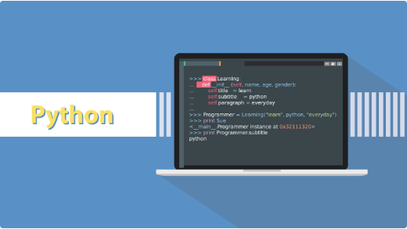
Technical Integration & Explainable AI
Explainability (Grad-CAM)
In medical AI, trust is key. We use Grad-CAM logic to highlight the exact regions of the brain scan that influenced the model's decision.
•
Identifies "Fired" neurons in final layer
•
Generates Superimposed Heatmaps
•
Validates tumor boundaries visually

Slide 11
References & Technical Sources
▪
Xie, Y., et al. (2022). CNN Techniques for Brain Tumor Classification. Healthcare.
▪
Project Data: masoudnickparvar/brain-tumor-mri-dataset (Kaggle).
▪
Dorfner, F. J., et al. (2025). Review of Deep Learning for MRI. Nature Oncology.
▪
▪
Mansour, H. M., et al. (2024). Near-Infrared Fluorescence Imaging. Cancers.
▪
Libraries: TensorFlow v2.15, OpenCV v4.8, Streamlit Dashboard.
Hardware: NVIDIA T4 GPU Acceleration environment.
Thank you for your time.

